Slide 1


Installation Training
2022

Slide 2
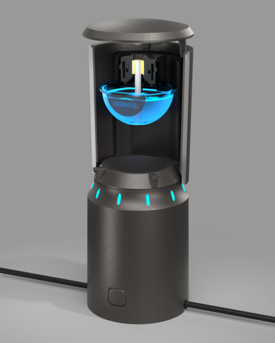
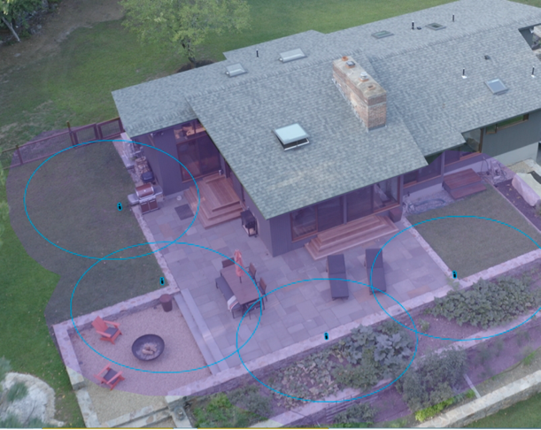
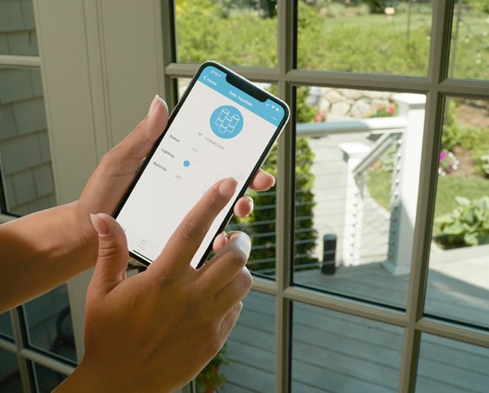
Agenda
Introduction
Configuration
Installation
Connectivity
Monitoring Systems & Supplying Refills
Notes:
When we say the next level, for Thermacell we mean
-Taking our highly effective mosquito repellent and
-1. Making a larger zone of protection
-2. Providing long lasting protection
-3. Making it easy for the consumer – so easy they don’t ever have to think about it.
We've been working on this for the past 3 years

Slide 3
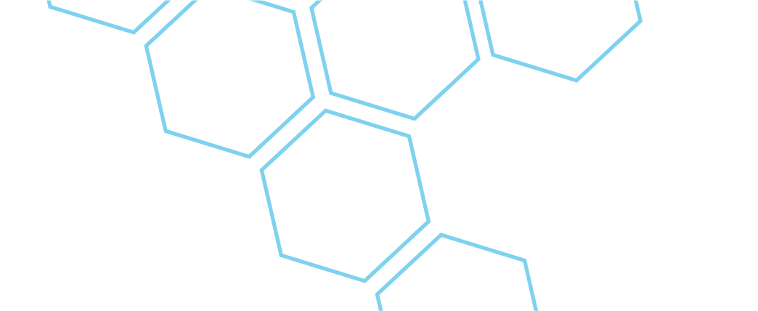
Product Introduction
Notes:
Positioning Professional for Success

Slide 4


20 years of Legendary Performance
Thermacell heat activated repellent products create an unmatched zone of protection from mosquitoes and other insects where and when you need it.
©2020 Thermacell Repellents Inc. (Confidential)
Notes:
0. Who here has a Thermacell
1. Thermacell creates a 20 ft zone of protection by heating repellent into the air. It is not a spray or lotion.
2. Thermacell provides highly effective coverage and has been proven effective in some of the most mosquito dense places in North America. Whether fishing in the Everglades, hunting bears in Manitoba, camping with the Boy Scouts in the Boundary Waters of Minnesota. Thermacell enables people to be outside enjoying their favorite activites.

Slide 5
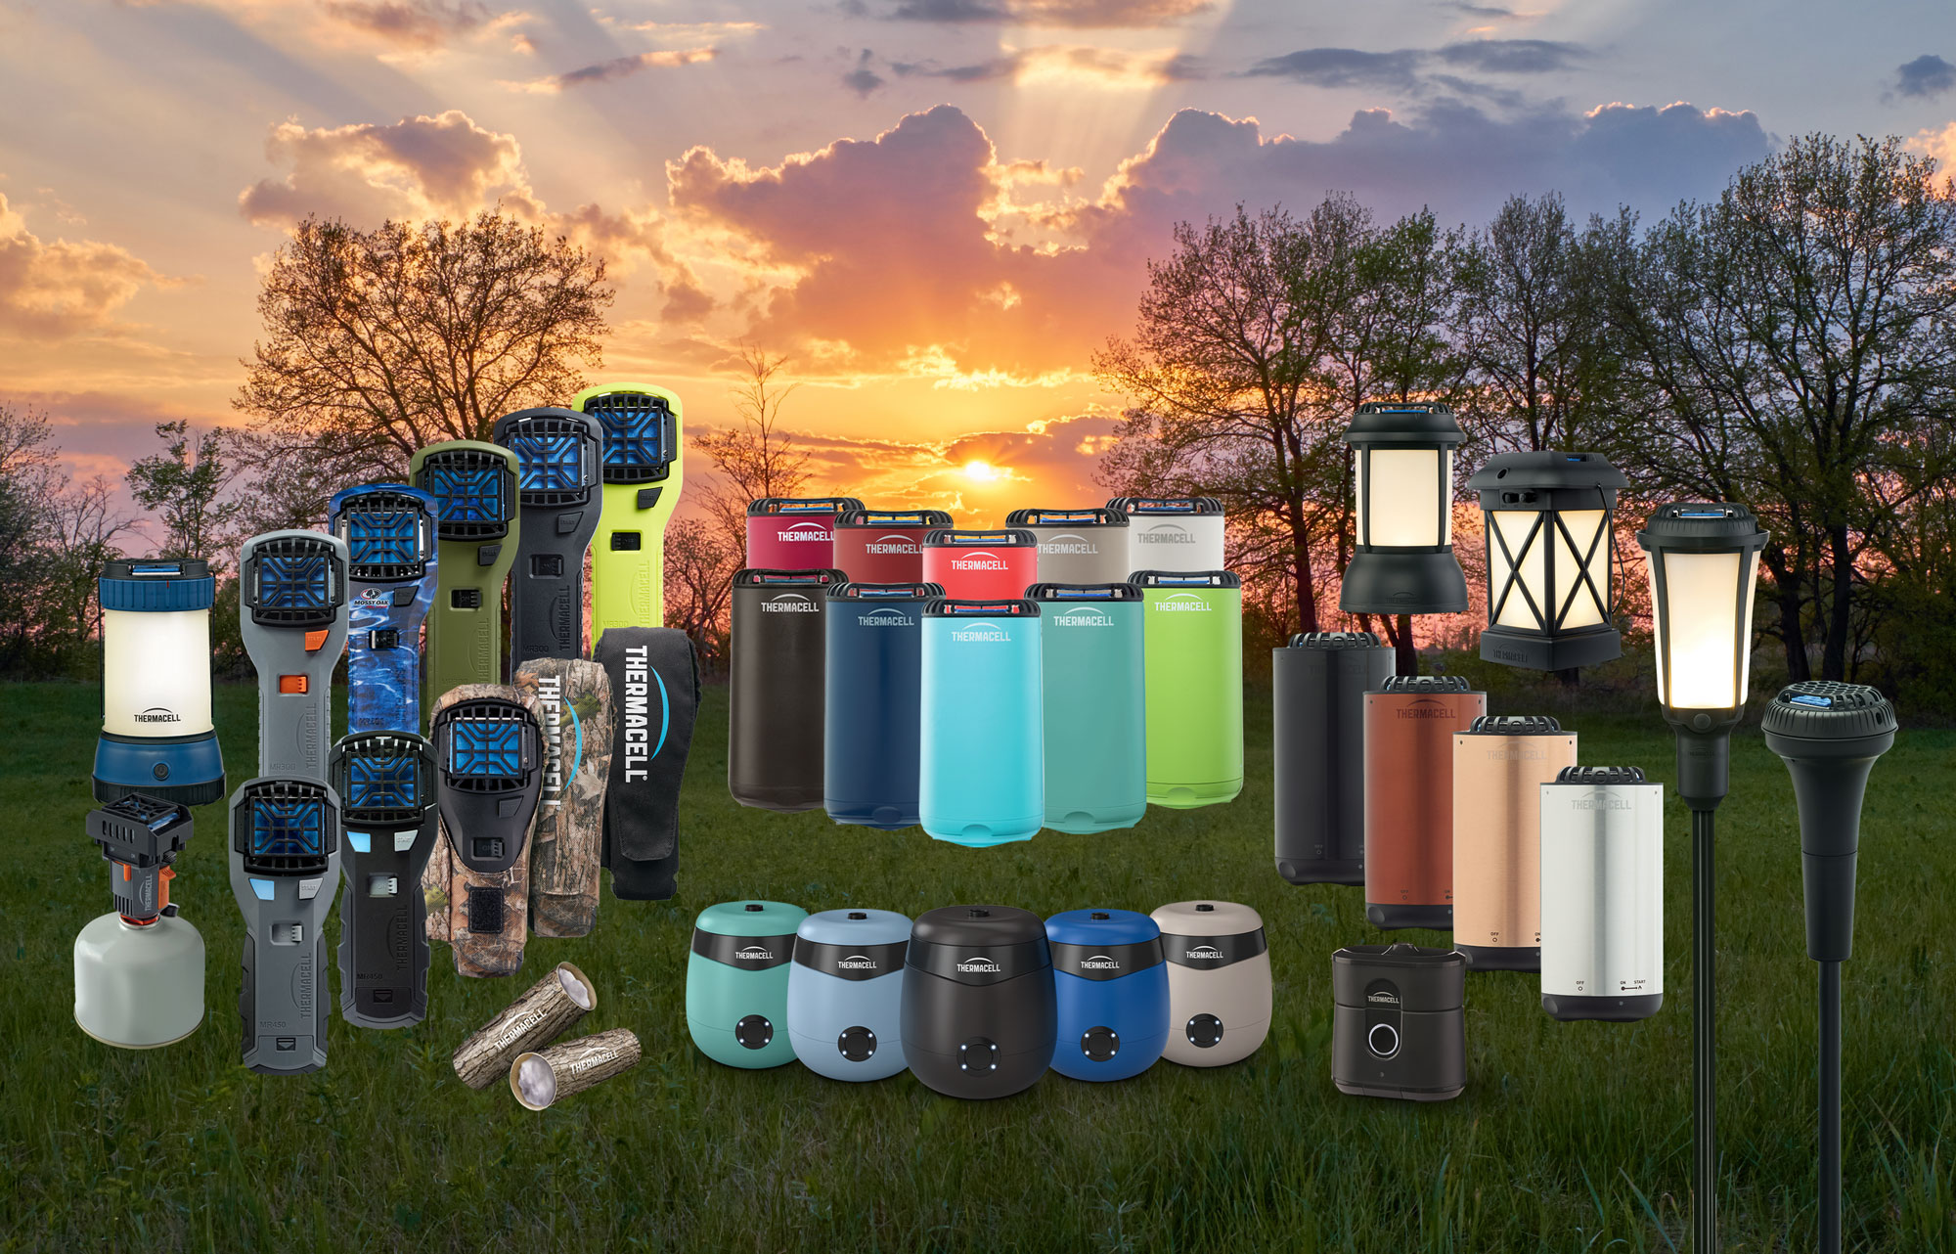
5 Million+ users across North America
From the backyard to the backwoods, consumer have relied on Thermacell Products to deliver effective protection
Effective
Easy to Use
Convenient
Notes:
Thermacell has sepnt a lot of time on innovation to make great products:
Highly effective, easy to use, convenient. Thermacell works by heating repellent into the air to create the zone of protection

Slide 6
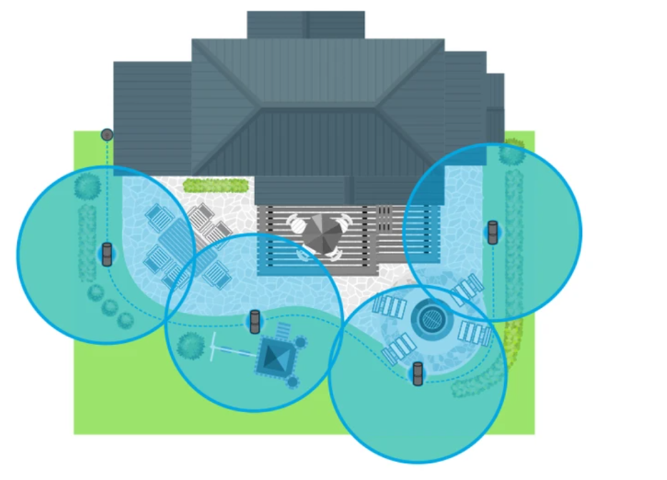


We’re taking backyard mosquito protection to the next level…
  Permanently-installed
  On-demand protection
  Completely integrated
  Fully customizable
  Maintenance-free
  Environmentally friendly
Notes:
When we say the next level, for Thermacell we mean
-Taking our highly effective mosquito repellent and
-1. Making a larger zone of protection
-2. Providing long lasting protection
-3. Making it easy for the consumer – so easy they don’t ever have to think about it.
We've been working on this for the past 3 years

Slide 7

Click here for video

Slide 8
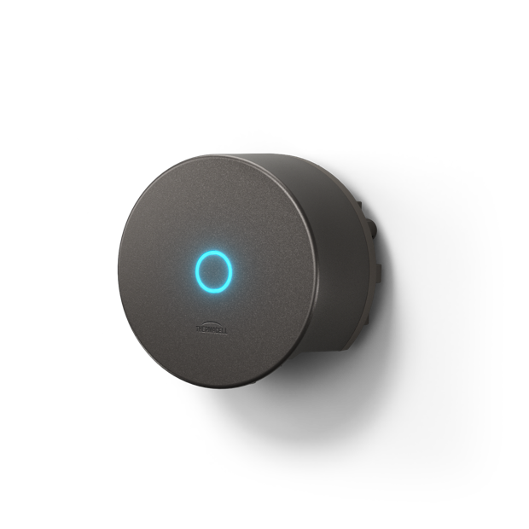
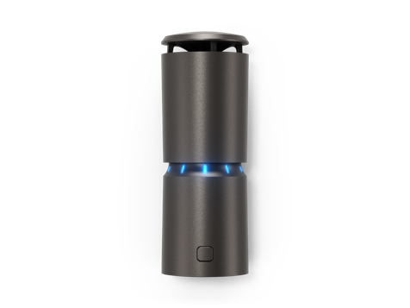
On demand mosquito defense
Permanently installed, die-cast aluminum, all-weather design
Repellers diffuse heat-activated repellent in priority zones
WiFi-enabled SmartHUB provides one-touch system control + more
No-scent repellent formulation delivers consistently effective protection
Notes:
All parts are made to last – die cast, high quality, premium look and feel;

Slide 9
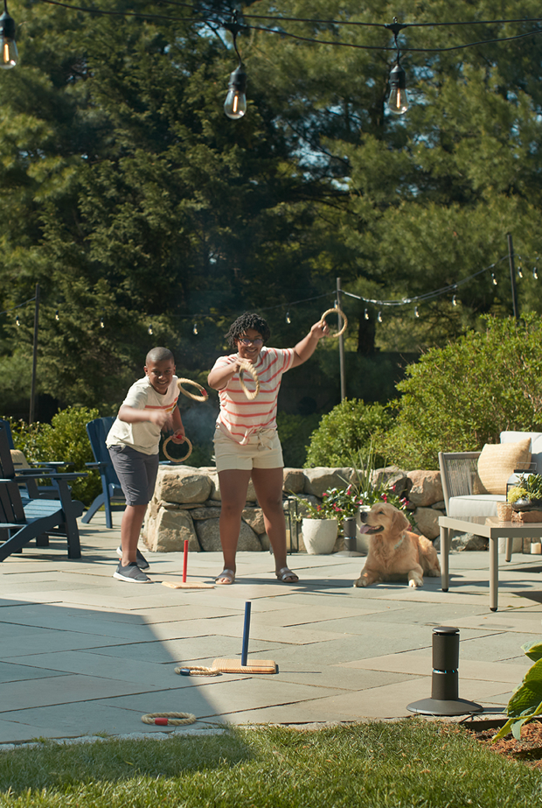
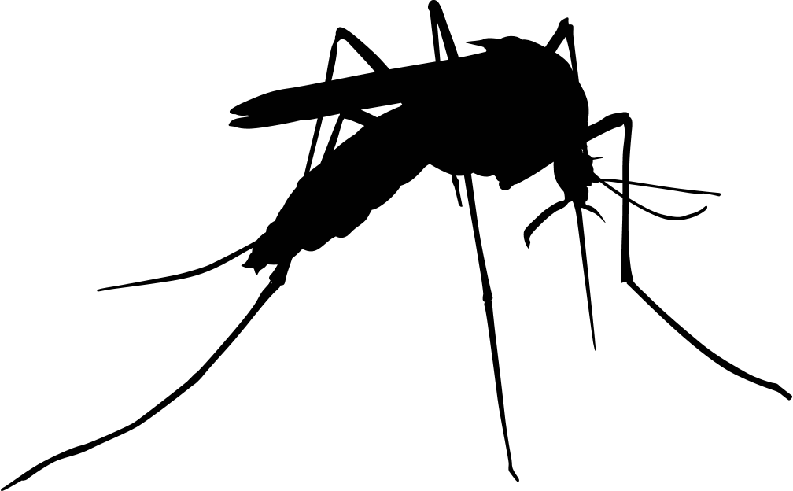



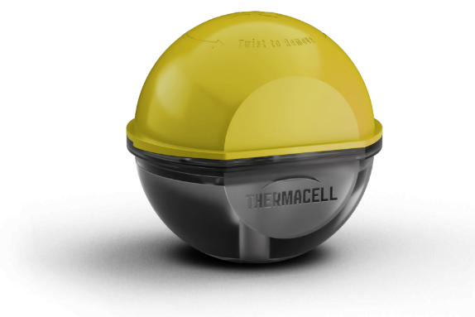
Effective protection. All season long.
Proven effective EPA registered 5.5% methofluthrin formula defends against mosquitoes & EPA pending action for other biting insects
On-demand - Up to 40 hours of active repellency per cartridge between replacements
No-scent formulation
Mosquitoes
Midges
No-see-ums
Thermacell Repellency field tests, May 2019
Notes:
Repellency is driven by the repellent formulation
5.5 Metofluthrin formula
We have a robust data set, accepted by EPA, multiple sites and multiple species, 85%+ reduction in mosquitos even at 10’ away
Even tougher to please than EPA is the consumer, where we’ve seen 98% T2B satisfaction scores in our 400+ test homes we installed this summer

Slide 10
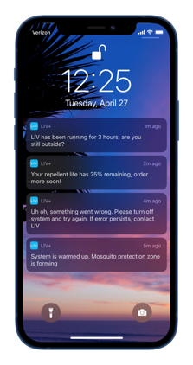


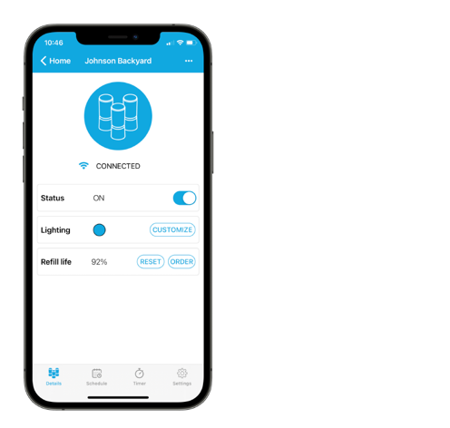
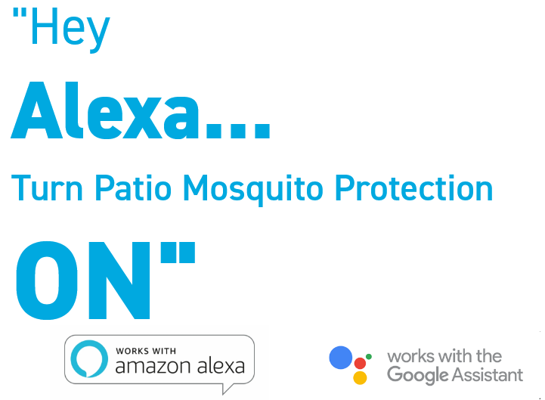
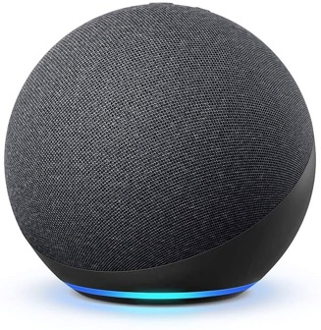





Control from anywhere.
Unlock another level of freedom and control:
Turn on/off from anywhere
Set schedules & timers
Customize repeller lighting
Monitor cartridge level (beta)
Enable push notifications
Share system control
(Confidential)
©2020 Thermacell Repellents Inc.
Notes:
LIV's smart system provides easy control, allowing the owner to customize at the touch of a button.
1. Mon – Fri schedule
2. Turn off
3. Timer for off
4. Refill guage ( - better order more from my professional)
5. Light features

Slide 11

Configuration

Slide 12
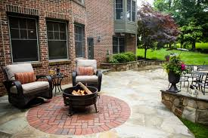
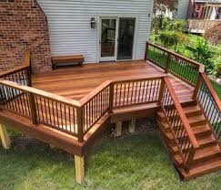

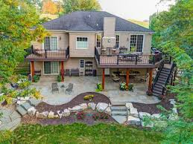
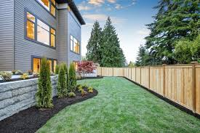
How to approach a configuration
Plan
Patios
Install
Decks
Commercial/Other Areas
Connect
Patio/Deck Combos
Small Backyards

Slide 13
30-Second Assessment, Think like a pro!
Plan
Here are a few considerations when selecting homes:
  Coverage Area:
    Is this a concise, high traffic area?
    Will <6 repellers cover the area? (If not, consider adding another hub to power additional repellers)
  Power & Connectivity:
    Is there an outdoor GFCI outlet near the coverage area?
    LIV runs on 120 volts and needs standard 12V
    Is there Wi-Fi signal near the outlet?
  Cable Plan: How can you run the cables for a clean install?
Install
Connect
Notes:
Move through this faster…

Slide 14
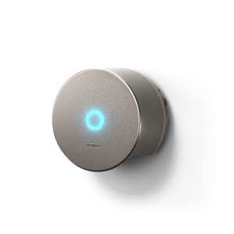
A system designed for durability and ease of use
Smart Hub
Control system by button or via app
Repellers
Provide fixed point protection where you need it
Interconnecting cables
Low Voltage, multi-conductor wiring connects repellers to Smart Hub; tough, and rated for direct burial.
  Various mounting solutions:
  Options provide installation flexibility
Universal Mount allows for direction attachment to decks and more
Ground stakes for in-ground installation
Hardscape base for on-surface install
©2022Thermacell Repellents Inc. (Confidential)
Notes:
All parts are made to last – die cast, high quality, premium look and feel;

Slide 15
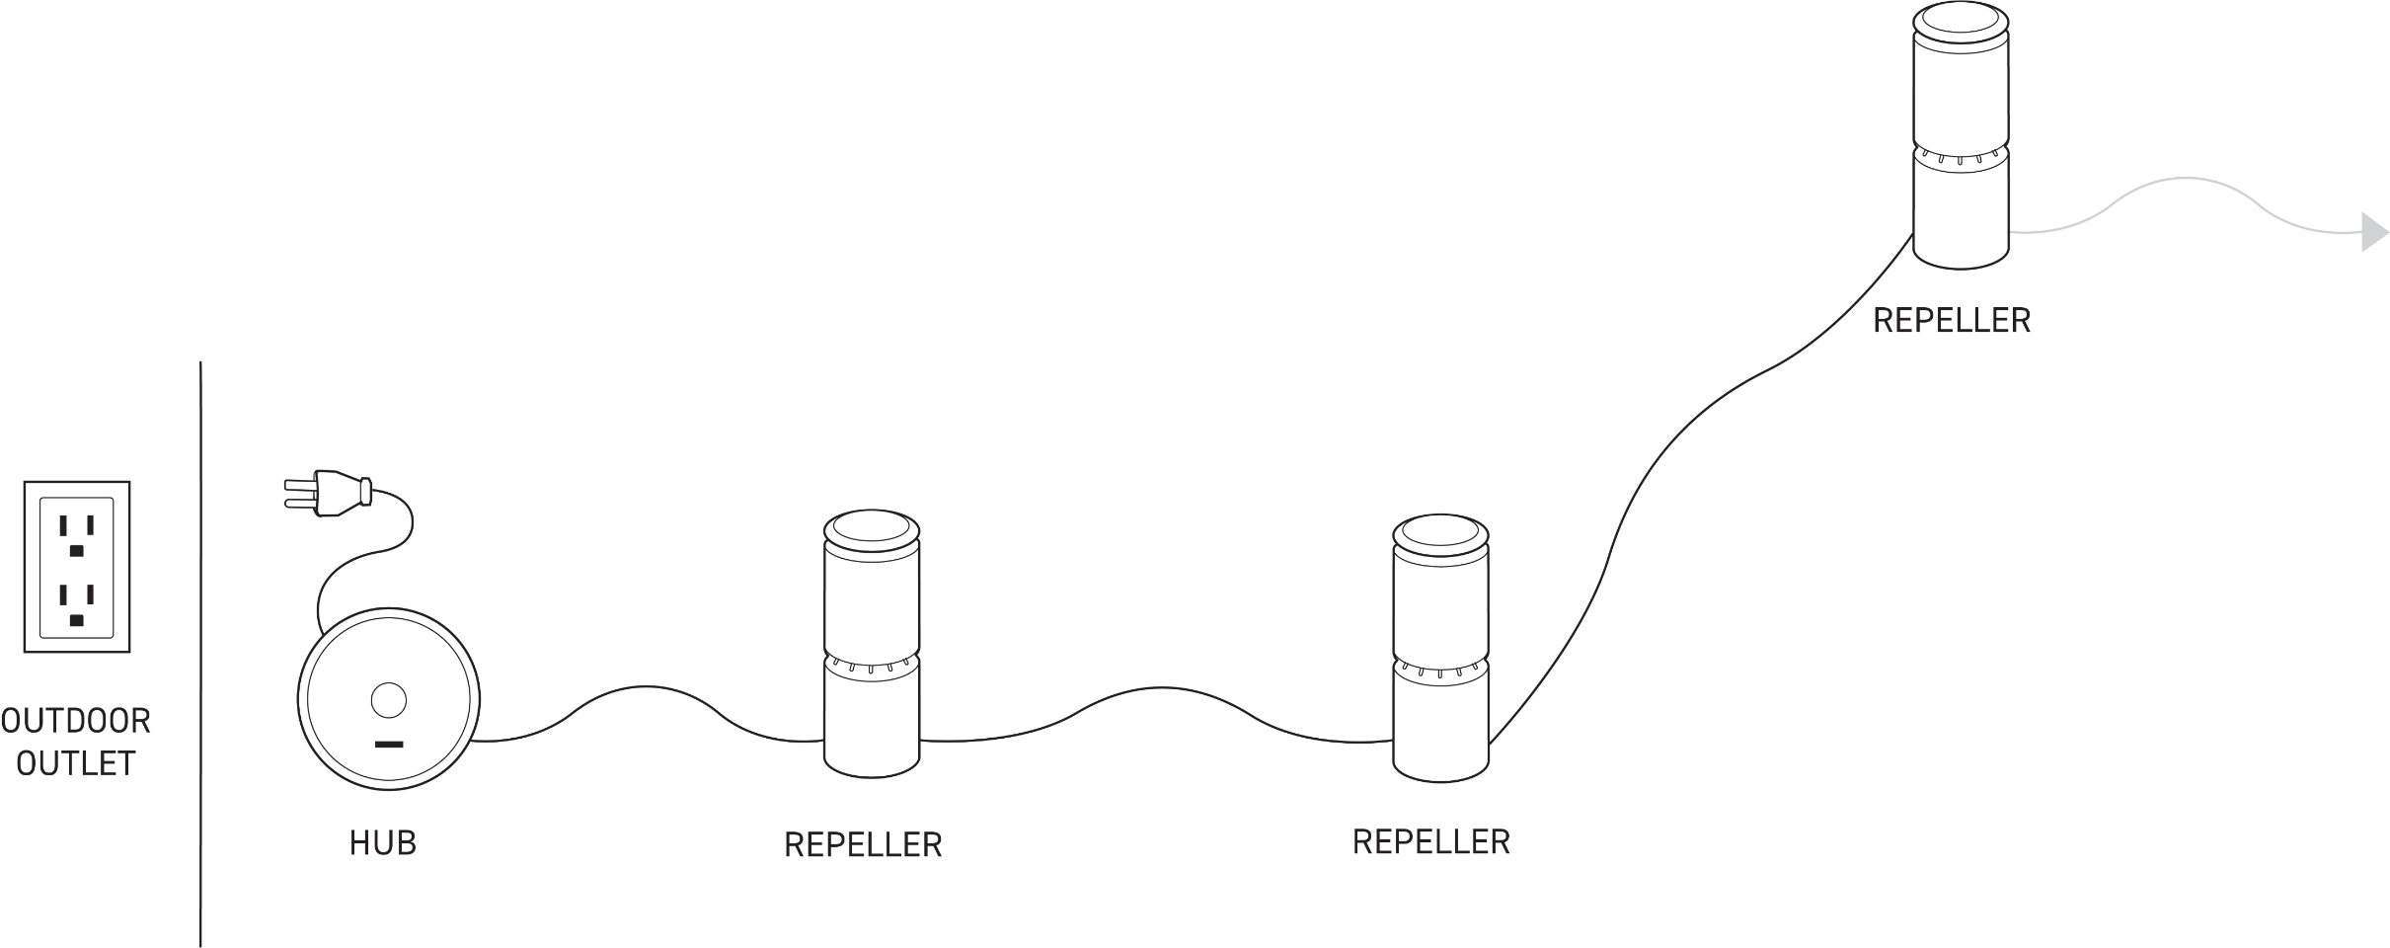
Basic Configuration
Plan
System Specifications
Repellers go in one direction starting from the hub. They do not split directions, nor do they circle back to complete a circuit.
Each Smart Hub can support up to 6 repellers.
Repellers are not controlled individually, they work as a system.
Repellers can be arranged to cover separate zones or can work together to form a larger area of protection.
Install
Connect

Slide 16
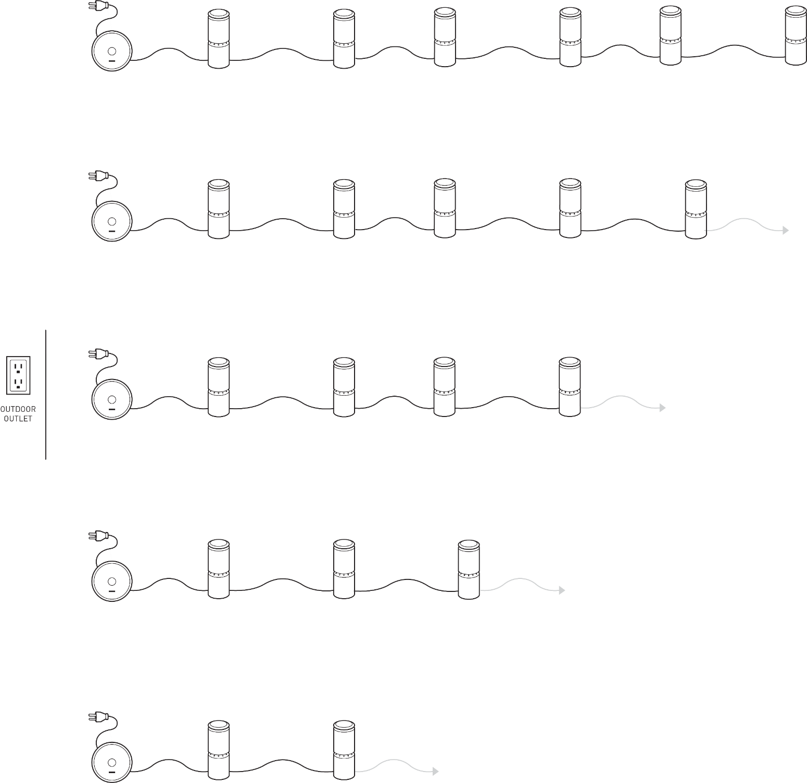
*
Basic Configuration
Maximum Cable Length
Plan
180 ft
Maximum distance between Hub and final repeller by number of repellers
For a low voltage system, maximum system distance decreases as additional repellers are added to the chain
If your system design requires additional cables and exceeds the maximum length allowed, another hub must be added to power additional repellers
240 ft
Install
400 ft
700 ft
Connect
* Up to one 24’ and one 10’ cord can be added to a 6 repeller system. If additional cord is needed, add an additional hub.
1000 ft

Slide 17
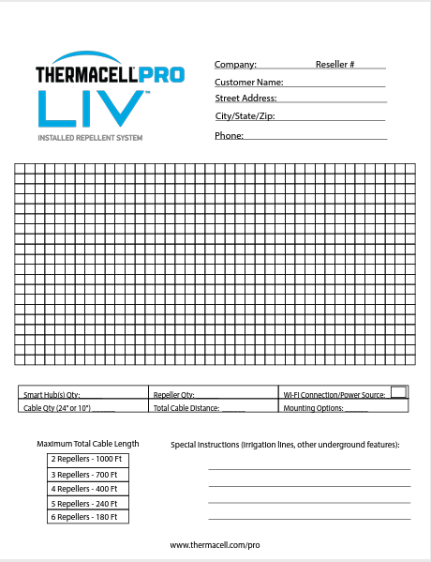
Designing a System
Plan
Professional will inspect, draw up design and provide final pricing
  Complete a graph
  Determine location of Hub
  Determine how many repellers
  Determine if lines need to be buried or attached to a deck
  Review design with client
  Complete agreement
Install
Connect

Slide 18
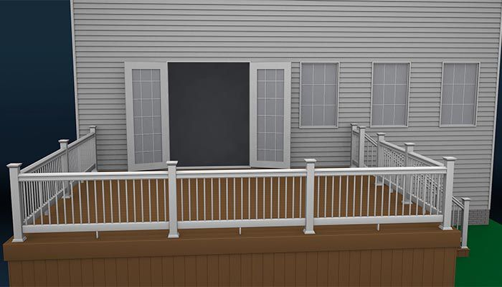





How to configure a deck
Coverage Area
Power Availability
Cable Plan
Plan
Install
12’
Connect
18’
Notes:
First let’s establish the dimensions. We’ve assessed the dimensions to be 12 x 18. Not a huge area, which is great, because we can cover the whole deck.
Next, determine where the outdoor outlets are, we see there are two
After, let’s choose where to place the Smart hub, let’s choose on the deck since it seems to be easier.
Lay out where we might place repellers, staggered so that the whole deck is covered. 1 by the stairs, the second in the middle front of the deck, and the third in the middle side. That will keep the doors clear as well.
Then assess how we will lay out cables, there is plenty of cable so distance isn’t an issue, but since we want to keep things linear and untangled, we see that the HUB placement isn’t as simple as we thought. We should move it to the back outlet, It will keep cabling off the deck, and we won’t have to double back at any point.
So we move the Hub to the back, and then can successfully cable the repellers in a single line.
At this point, we’ve established the number and location of repellers, time to have the conversation with the homeowner, “How do we want to mount them?” The two options for decks are the universal mount, included with each repeller, and the hardscape base, which is a separate accessory. Using the universal mount is clean, low profile, but more permanent – install with two deck screws - may not be preferred for wood like IPE and other expensive hardwoods. The base is easy and moveable, which is great. Ultimately up to the homeowner how they want this to be installed.

Slide 19
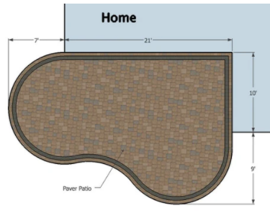
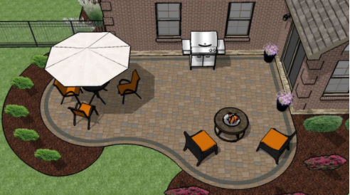

Coverage Area
Power Availability
Cable Plan
How to configure a patio
Plan
Show configuration, ground stakes, discuss trenching
Install
Connect

Slide 20
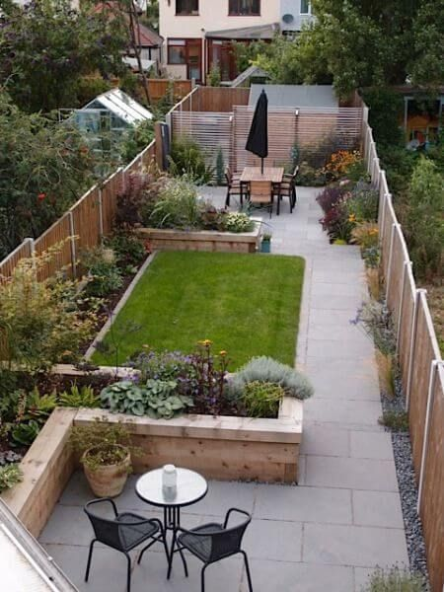

How to configure a small backyard
Plan
  Other Points to Consider
  Where will we run the cables?
  What mounts should we recommend?
  What is the right sequence of the repellers?
Install
12ft
  Try to install 12-18” away from dense plants/natural barriers/walls
32ft
Connect
Notes:
This backyard looks a little different than a simple deck or patio. How should we approach it? Here are the dimensions, what other considerations are there? ANIMATION FOR LIST
Sometimes the shortest path isn’t the most direct.
Now notice that the repellers on the right are close to the fence? Nearly half the area of protection for those repellers isn’t in the usable backyard. They would have to be anchored into the pea stone, which will be difficult. Additionally, the homeowner might have kids that they don’t want running and kicking over repellers. So what is a different approach we can take to make it cleaner and more efficient? NEXT SLIDE

Slide 21
How to configure a small backyard
Plan
  Other Points to Consider
  Where will we run the cables?
  What mounts should we recommend?
  What is the right sequence of the repellers?
Install
12ft
32ft
Connect
Notes:
Using the same checklist, we can get a very different result.
Don’t need to have a continuous zone – focus on the traffic areas – table and chairs.

Slide 22
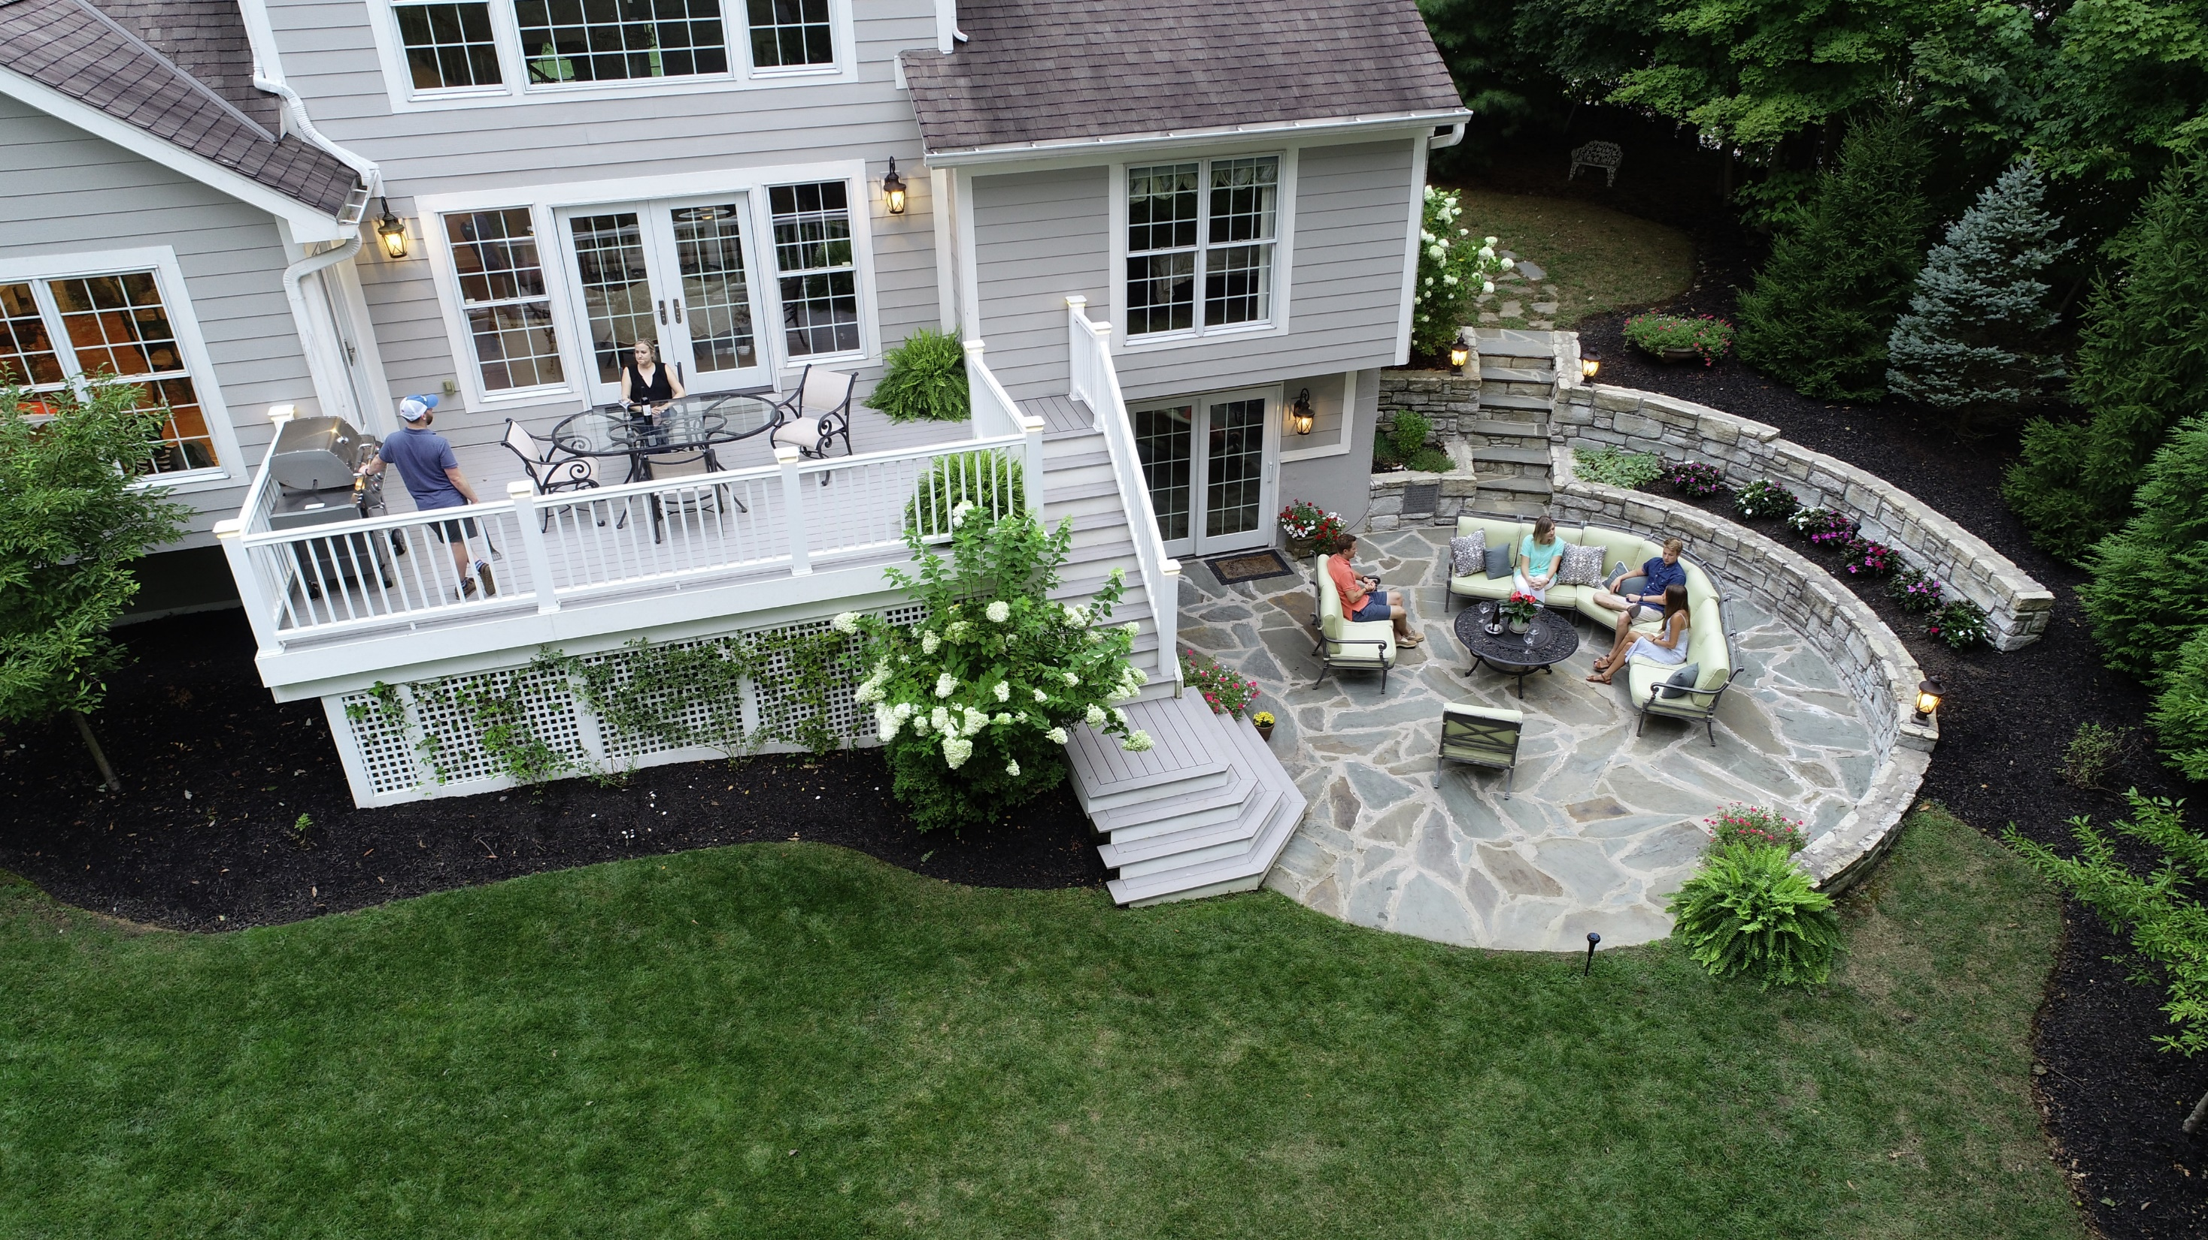
Notes:
Now it’s your turn – Let’s assess the backyard, what spaces are clearly used and likely to be areas we want to protect.
Let’s find the dimensions…

Slide 23

7’
14’
14’
Notes:
Here are the dimensions you took – and the three accessible GFCI outlets you’ve found.
SKIP NEXT SLIDE IF PROS SHARE THEIR EXAMPLES

Slide 24


7’
14’
14’

Slide 25
Installation

Slide 26
What you’re receiving from us
Clear some space for LIV, we’re sending you a few things…
LIV orders will be shipped to you on a pallet, containing cases:
For example, an order may contain:
6 Smart Hubs
24 Repellers
10 extra 24’ Cables
10-10’ Cables
12 Hardscape Bases
72 Repellent Cartridges

Slide 27
What you’ll need
Plan
The customer should be home during the installation.
Hub x1
Repellers (2-6) (each comes with a ground stake and 24’ cable)
Repellent Cartridges (1:1 match with repellers)
Additional 24’ and 10’ cabling (in case you need it)
Mounting accessories
  Hardscape Base(s)
Install
Installation Tools
Drill with 1/8” bit, additional masonry bit
Trowel/Shovel
Tape Measure
Phillips Head Screwdriver
Customer Home Wi-Fi network password
Connect

Slide 28
Lay Everything Out
Plan
Install
Walkway?
Connect
Notes:
Check the homeowner – E.g. Repeller 2 is in a major walkway, ensure that you accent, not impede, how they use their space.

Slide 29
Confirm Plan with Homeowner
Plan
Ground Stake
Install
Ground Stake
Cover with Mulch
Cover with Mulch
Hardscape Base
Dig
Connect
Notes:
With the homeowner, you should confirm the plan again – where and how you plan to mount the smart hub, where you will need to dig, where you plan to bury cabling, and which mounting accessories you plan to use, particularly if you choose to drill into a deck or stone.

Slide 30
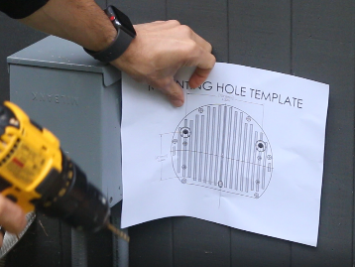
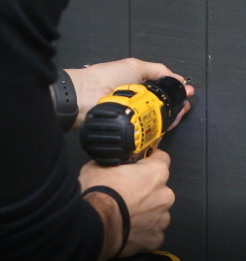
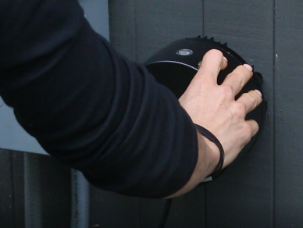
Mounting the Hub
Plan
Install
Choose placement of the Hub to be within 6’ a GFCI outlet, ideally on the side of the house near the utilities, or on a stake/post. It must also be 30” above the ground to avoid exposure to water/snow/other elements.
Using the provided mounting template, mark and drill pilot holes (1/8” bit). Install the screws by using a drill bit or Phillip’s Head Screwdriver
Once the screws are seated, hang the Hub on the structure by aligning the screw heads with their corresponding hooks on the Hub.
Install Hub where connectivity is strong. Check app to make sure it is connected.
Connect

Slide 31
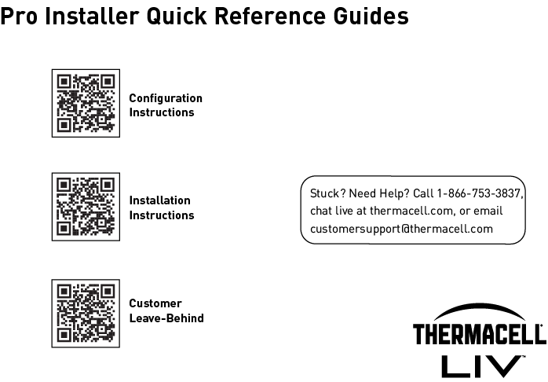
When you’re knee deep in the flowers….
Plan
FPO
Install
FPO
FPO
Connect

Slide 32
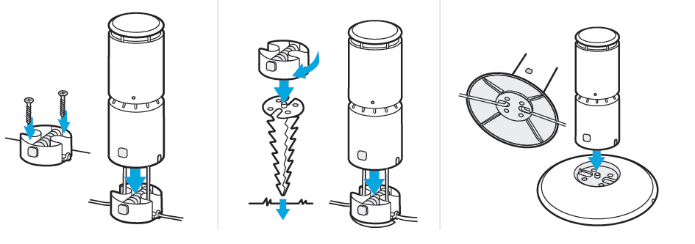
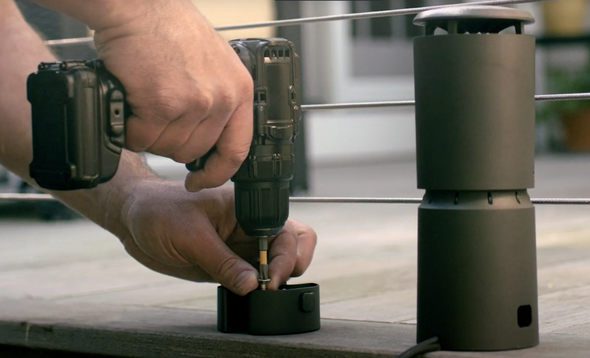

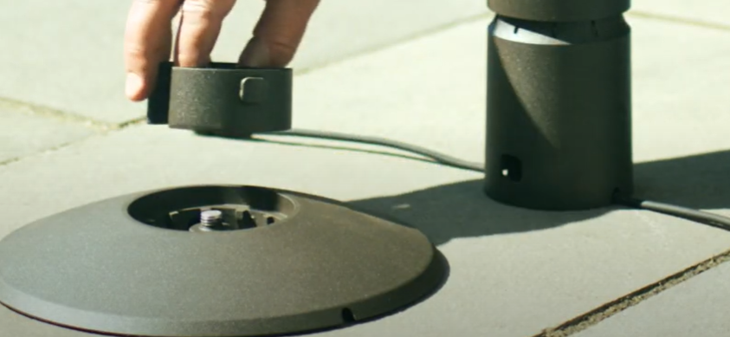
Mount the Repellers
Plan
Install
Direct Mount
Ground Stake Mount
Hardscape Base
Connect
Notes:
Here’s what you can expect.

Slide 33
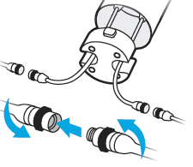
Connect the Repellers
Plan
Install
Connect a cable from the Hub to the end of the corresponding pigtail on the first repeller
Connections should be threaded finger tight, do not use tools or over-tighten.
Then connect the other pigtail of the first repeller to the proper pigtail of the next repeller in sequence, repeat until all repellers are connected in a single chain.
Connect

Slide 34
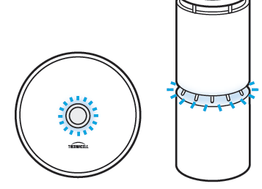
TEST the Repellers
Plan
Lights circle from left to right, around the device
Install
Plug in the hub and press the power button. The ring around the Hub button should light blue. Check each repeller to ensure they are illuminated.
Lights are located halfway up the repeller and circle the entire device. A chasing “amber” light indicates that the repeller is heating up (functioning normally).
Turn off the system by pressing the power button on the Hub. Continue with final installation of the repellers and cables.
Connect

Slide 35
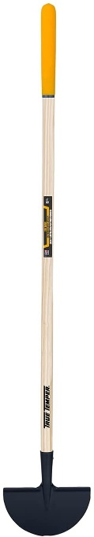
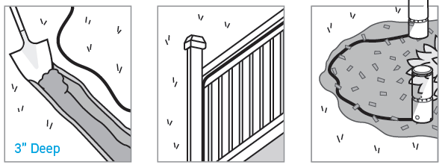
Secure the Cables
Plan
Bury
Run Above Ground
Cover with Mulch
Install
1-2” deep
Connect

Slide 36

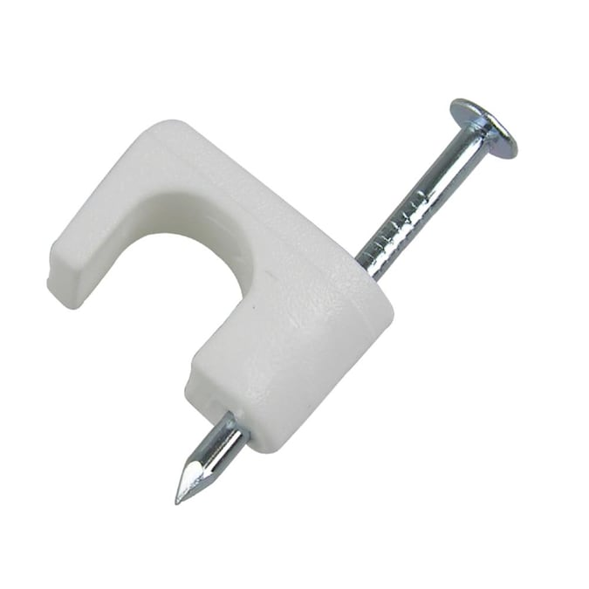
Tools We’d Recommend
Plan
Edging tool for cable burial
Install
Coaxial Cable Tacks for above-ground cable management
Connect
Notes:
Tool is a lawn edger

Slide 37
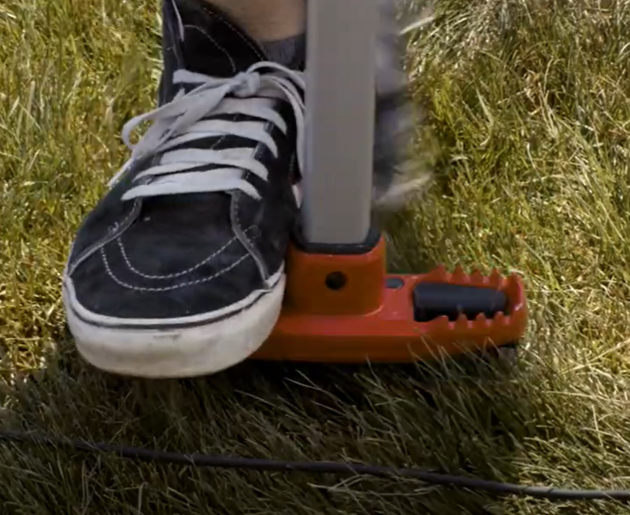
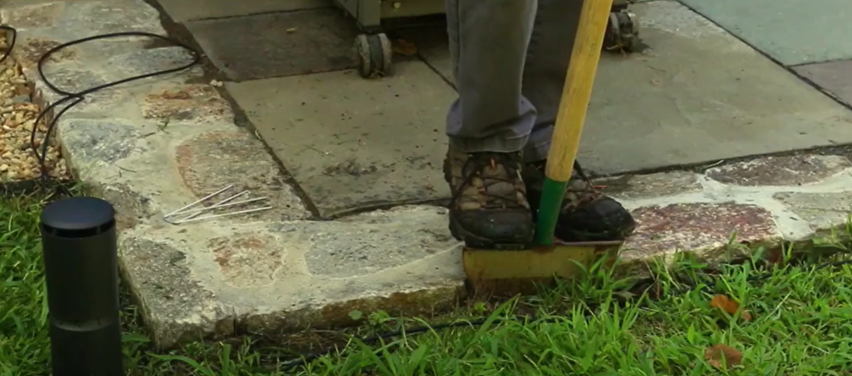
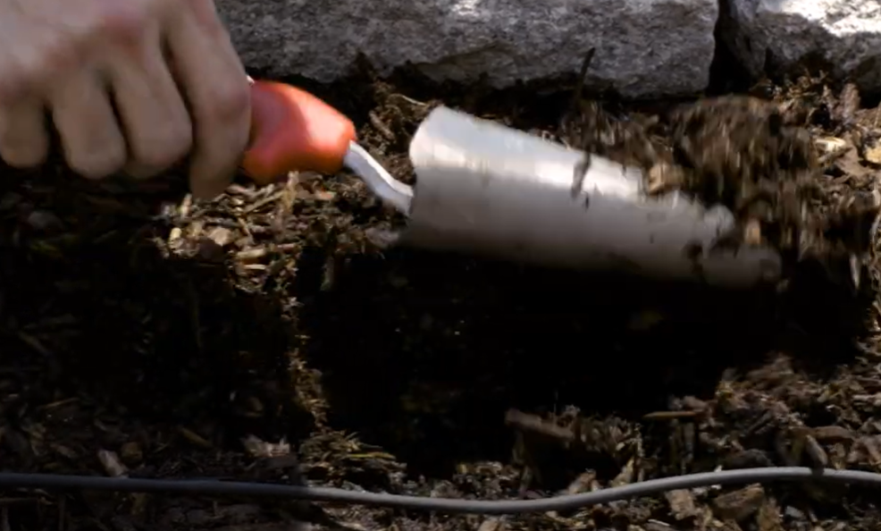
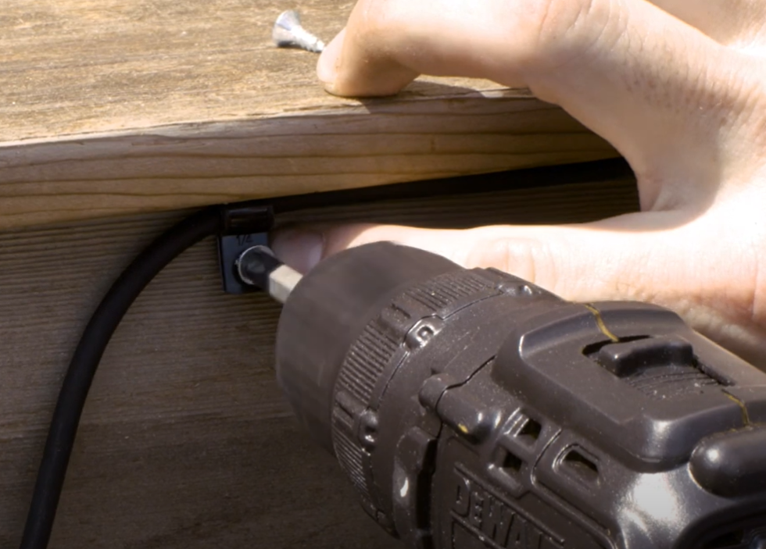
Helpful Hints for Securing Cables
Hide cabling as appropriate
Plan
Install
Connect
Notes:
Tool is a lawn edger

Slide 38
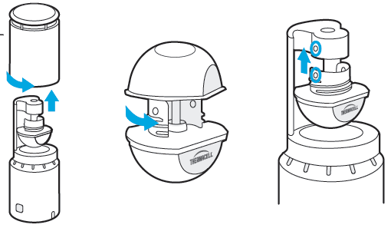
Insert Repellent Cartridges
Plan
Remove the repeller hood by twisting ¼ turn counter-clockwise
Remove the cap from the cartridge by twisting the cap counter clockwise.
Align the cutouts on cartridge with bumps on repeller head, press up until you feel it click into place.
Replace the repeller hood and the system is ready to operate.
Use the included Allen key to lock the repeller and prevent access by pets/children, etc. The repeller will need to be unlocked in order to service/replace cartridges.
Install
Note: Cartridges attach easily, but are more difficult to remove.
Connect
Notes:
Alex – do live demo?

Slide 39
Connectivity

Slide 40
Connect to Thermacell LIV+ App
Plan
If the customer is home
If the customer is not home
Walk them through the connection process on their phone.
Come back at another time to complete the connection process.
Leave connection instructions with the customer for them to work through or walk them through over the phone.
Install
Connect
* Best Practice: Recommend the customer download the app and set up their account before installation, when sales sets up the installation appointment.
Notes:
Have team run these steps if possible

Slide 41
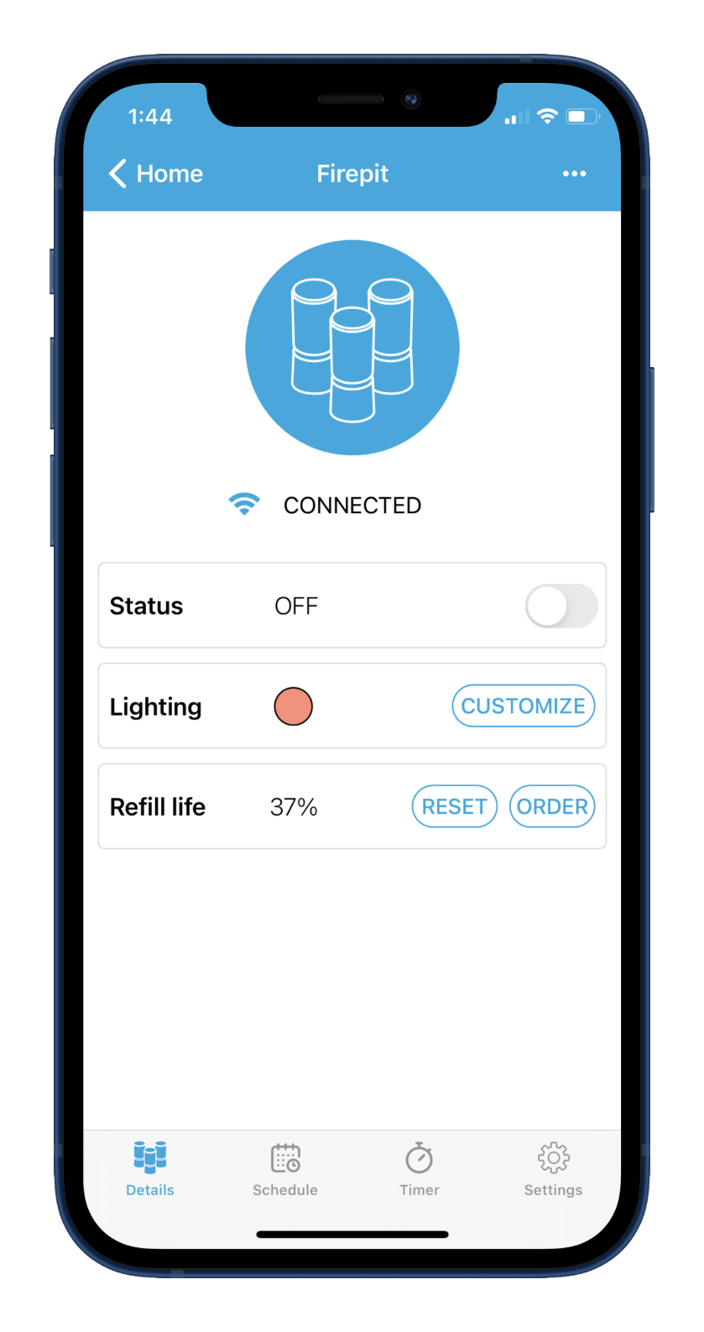

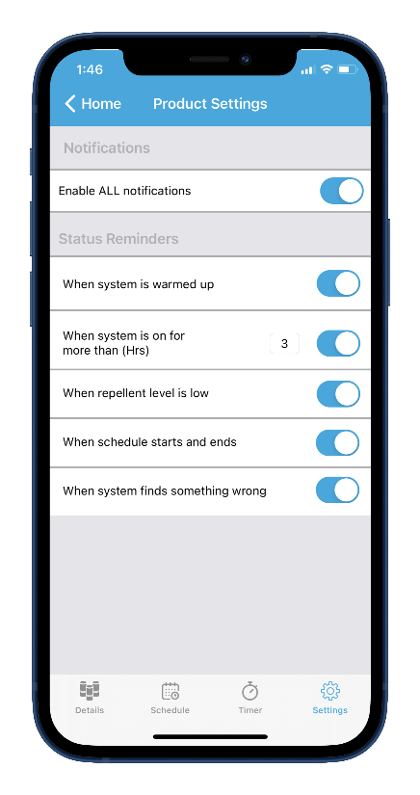
Connect to Thermacell LIV+ App
Plan
Ask the customer to download the LIV+ app onto their phone. From the app store enter in Thermacell LIV and look for the icon
Customer creates account in the app
Follow app directions, ensure connecting to 2.4 GHz network
Connection to the LIV+ app enables professionals to monitor usage data and estimated repellent levels.
Install
Connect
Notes:
Have team run these steps if possible

Slide 42
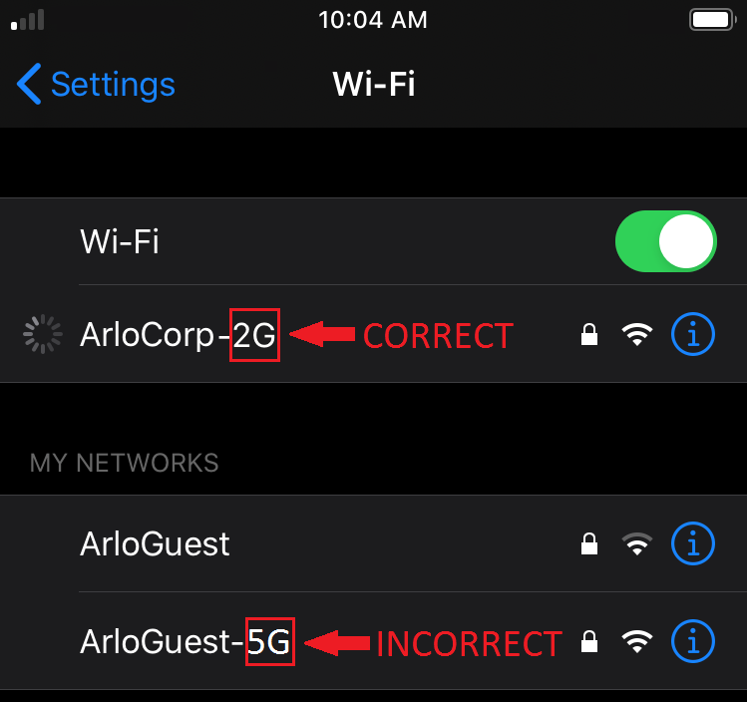
LIV Connection: 2.4 GHz vs 5 GHz
When connecting LIV device to a WiFi network, select the SSID that indicates it is a 2.4 GHz network. This is typically indicated by a 2, 2.4, or 2G at the end of the SSID.
Plan
Install
If the customer’s WiFi network name or SSID doesn’t indicate whether it’s 2.4 GHz or 5 GHz:
Have them open their router settings and look for a 2.4 GHz WiFi network that a mobile device can connect to. If they need help with this, they should contact their router manufacturer.
They can also contact their Internet Service Provider (ISP) and ask for help connecting their mobile device to a 2.4 GHz WiFi network.
For networks that have the same SSID for 2.4/5 GHz: Try temporarily disabling 5 GHz in the router settings.
Connect

Slide 43
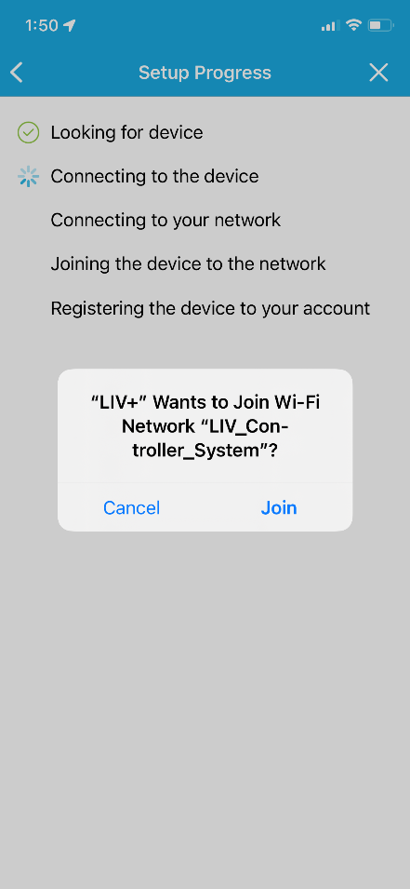
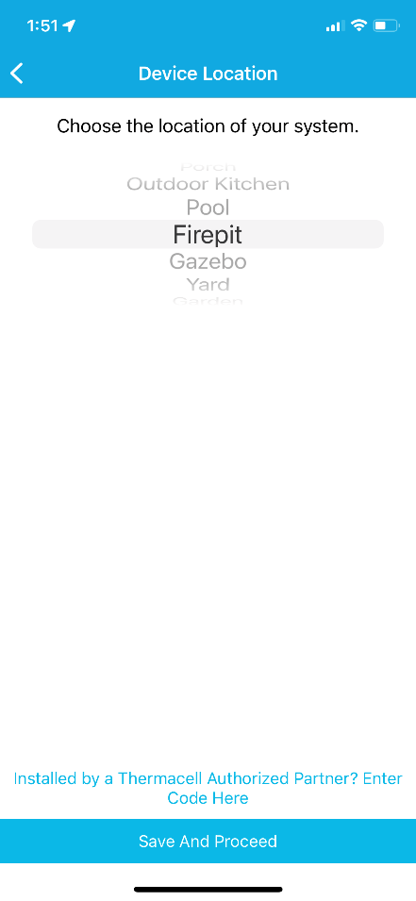


Connect to LIV+ App
Plan
Follow the onboarding instructions in the app
Enter your dealer/franchise code (provided by Thermacell) for the product to be logged with your franchise for data reporting, warranty registration, rebates, etc.
Select the location of the device and then click the link at the bottom for Thermacell Authorized Partners
Install
Connect
Notes:
Have team run these steps if possible

Slide 44

Thermacell Reseller Numbers
Plan
E.g. Reseller Number 240999
Reseller numbers are generated by Thermacell, and are unique to every franchise/professional office
Reseller numbers are reference numbers to use on Purchase orders, sales orders, rebates, and for device management
In order to see devices on your dashboard and access customer support, your customer’s device must be linked with your reseller number.
Install
Connect
Notes:
Have team run these steps if possible

Slide 45

Connect to LIV+ App
Plan
Follow the onboarding instructions in the app
Select the location of the device and then click the link at the bottom for Thermacell Authorized Partners
Enter your dealer/franchise code (provided by Thermacell) for the product to be logged with your franchise for data reporting, warranty registration, rebates, etc.
Install
Connect
Notes:
Have team run these steps if possible

Slide 46


Connect to LIV+ App
Plan
The device details page is the “home base” for the customer’s device. From here you can control on/off, LED lighting of repellers, and estimated remaining refill.
Install
Press “reset ” refill life and select the refill you are installing so the device tracks the correct refill duration. This step should be completed upon installation and each time a technician replaces cartridges.
Connect
Notes:
Have team run these steps if possible

Slide 47





LIV System: Use with and without WIFI
Many LIV system features can be used even if the system isn’t on Wi-Fi
CLOUD
LIV+ App
LIV Functions with or without Wifi connectivity
Pro Dashboard
LIV Features with and without WIFI
Connected Features with WIFI* - Customer | System Features without Wi-Fi - Customer
Timers | Mosquito Repellency
Set Schedules | Reset Refill Life
LED Lighting Selection | Factory Reset
Push Notifications | Fault Reporting
% Refill Reporting | Refill notify via Repeller lights @ 25%, 10%, 0%
 | Auto Shutoff after 6 Hrs of Runtime
Connected Features with WIFI* - Professional
Usage Tracking
% Refill Reporting
Notes:
Thermacell will send you an email with this information.

Slide 48

Closing out the Install
Plan
Ensure the client has the leave-behind – the user guide
Install
Connect

Slide 49
Monitoring Systems
& Providing Refills

Slide 50

Pro Dashboard Process
Plan
URL: Pro.thermacell.com
Username: name + reseller “Kevin100110”
Password: LIV2022!
Install
Connect
Notes:
Thermacell will send you an email with this information.

Slide 51

Pro Dashboard
Plan
Install
Connect

Slide 52

Dashboard Help: Adding a customer after an installation
Plan
Connect
Find the form in the LIV Pro Support Center under “Tools” or click here.
Notes:
Thermacell will send you an email with this information.

Slide 53

Replacing Refills is as easy as 1, 2, 3
Plan
Insert new repellent cartridges in the repellers
Reset the Refill Life Timer. (Watch video)
  Press & hold the hub power button for 4 seconds.
  The LED ring around the button will flash 3X.
  Release the button. The timer will reset.
  What does resetting the hub do?
    Dashboard is reset, showing 100% refill life
    Customer’s app is reset, showing 100% refill life
    Internal timer on the hub will reset to 100% ensuring red refill LED indicators on repellers will flash when refill is low.
Email the customer (optional)
  Let them know the refill has been replaced.
  Their app now shows the refill at 100%
Install
Connect
100%
Notes:
Thermacell will send you an email with this information.

Slide 54

Refills: Change System Setting from 40 Hrs to 180 Hrs
Plan
Insert 180 Hr repellent cartridges in the repellers
Customer selects 180 Hr refills (grey cap) on their app
If customer isn’t home, use Hub to reset refills to 180 hrs. (Watch video)
  To enter refill selection mode, press and hold the Hub power button until a second series of flashes is emitted
  Release the hub power button to enter refill selection mode
  Click the Hub to cycle through the three colors that correspond to the refill amounts.
  Select the correct cap color for your refill (grey color = 180 Hr hours)
  Press and hold the Hub power button until the light turns solid.
  Release the button and your new selection will be locked in.
  What does resetting the hub do?
    Dashboard is reset, showing 100% refill life
    Customer’s app is reset, showing 100% refill life
    Internal timer on the hub will reset to 100% ensuring red refill LED indicators on repellers will flash when refill is low.
Install
Connect
Notes:
Thermacell will send you an email with this information.

Slide 55



Refills: When to replace them
Plan
Professionals
Check the dashboard. When refill life reaches 25%, the refill icon will turn red on the dashboard.
That means there are 10 hours left and it’s time to schedule replacement.
Ideally replace cartridges by 36 hours. Just like a car gas tank, the last 5% of life can be variable.
Install
Customers
At 25% refill life, the repeller will flash red 1x every 30 seconds.
At 25% refill life, the LIV+ app will send the customer a push notification to their phone.
At 0% the repeller lights will turn red.
Connect
Notes:
Thermacell will send you an email with this information.

Slide 56
Warranty
Plan
We’ve got you covered, for every system you install.
Thermacell’s Limited Warranty covers any and all defects in manufacturing quality and workmanship for 5 years (exclusive to professionally installed systems).
If a customer is experiencing a defective Hub or Repeller and troubleshooting doesn’t resolve the issue:
  Replace the part from your inventory.
  Contact Thermacell customer support at 781-778-7437. They’ll complete a warranty claim on your behalf and send you a return label for the defective item
  Send Thermacell the defective item. Once received, we’ll ship you a replacement.
Install
Connect

Slide 57
Additional Resources & Next Steps

Slide 58


LIV Pro Online Tools & Support
Thermacell has lots of materials online to get you up and running quickly.
Visit Thermacellpro.com and the Resource Center for the video library, guides and tools.

Slide 59
Tips & Tricks
Plan
Tips to troubleshoot a hardware problem:
Ensure cables are connected and secure
Walk the cable line to ensure no cables are cracked, chewed, or severed
Connect a different cable from the hub to the first repeller in the chain
Connect a different repeller directly to the hub
Contact Thermacell Support
Tips to troubleshoot a Wi-Fi Connection problem:
Make sure the phone is connected to the correct (2.4 GHz) network
Turn off “auto-join” of any competing networks at the home.
Move the hub closer to the router to connect, then mount in final location.
Disable Bluetooth and Cellular data temporarily to connect the hub
Attempt a factory reset of the smart hub by pressing and holding for 15 seconds.
Install
Connect

Slide 60
Next Steps - Contacts
Product
Tyler Sargent
Thermacell Repellents, Inc
Associate Marketing Manager, Installed Systems
tsargent@thermacell.com
P: (774) 745-2495
Customer Support
customerservice@thermacell.com
P: (781) 778-7437
Chat live at Thermacell.com
Program
Allegra Lowitt
Thermacell Repellents, Inc
General Manager, Professional and Tick Divisions
Allegra@thermacell.com
O: 781-430-5256
C: 617-359-0978
©2020 Thermacell Repellents Inc. (Confidential)

Slide 61
Appendix

